Slide 1

Modelling Wizard für Kabelmodelle

Slide 2




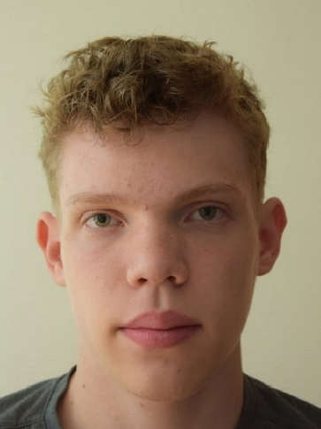



Die Kompetenzbolzen
Kevin Pauer
Projektleiter
MtrkNr. 1199719
inf20003@lehre.dhbw-stuttgart.de
Max Gohlke
Entwickler
MtrkNr. 9661798
inf20154@lehre.dhbw-stuttgart.de
Tim Sellemann Testmanager
MtrkNr. 8266096 inf20130@lehre.dhbw-stuttgart.de
Calvin Friedrich Produktmanager
MtrkNr. 5775099
inf20185@lehre.dhbw-stuttgart.de
Fabian Thomé
Entwickler
MtrkNr. 6316823
inf20190@lehre.dhbw-stuttgart.de
Thorsten Rausch Systemarchitekt
MtrkNr. 5895515
inf20082@lehre.dhbw-stuttgart.de
Leon Amtmann Technical Documentation
MtrkNr. 5156023 inf20071@lehre.dhbw-stuttgart.de

Slide 3
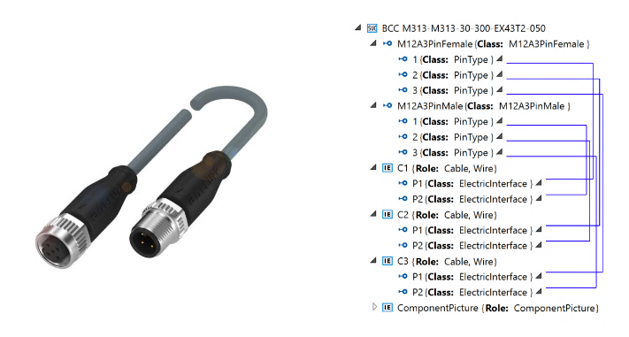
Vorstellung des Projekts

Slide 4









Verwendete Tools

Slide 5
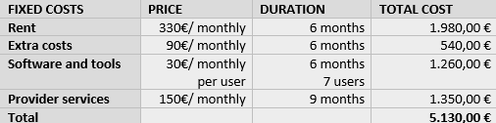
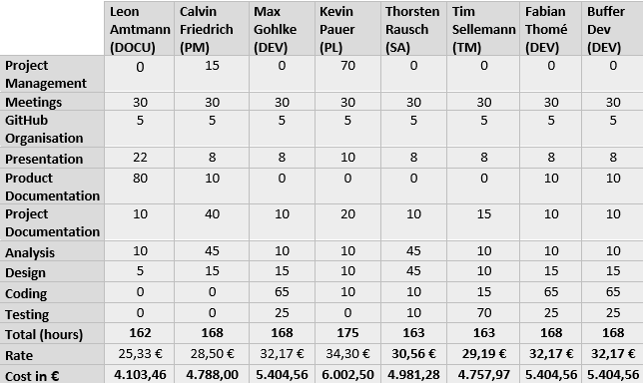
Business Case
Fixkosten:
Mitarbeiterkosten:
Insgesamt: 45976,89€

Slide 6

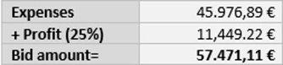
Business Case

Slide 7
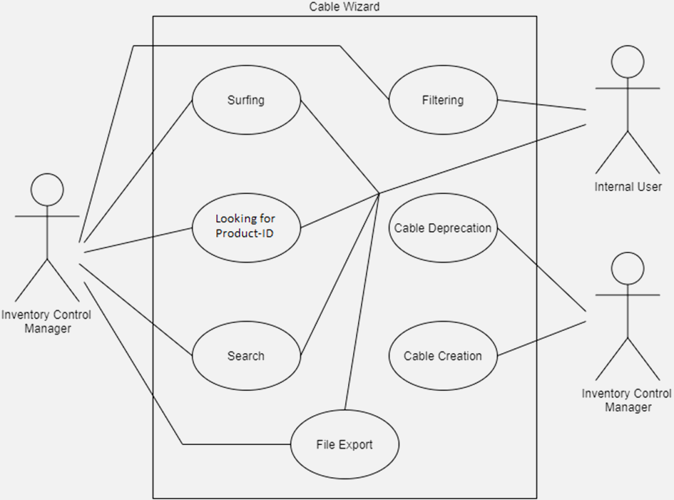
CRS
Use Cases:

Slide 8
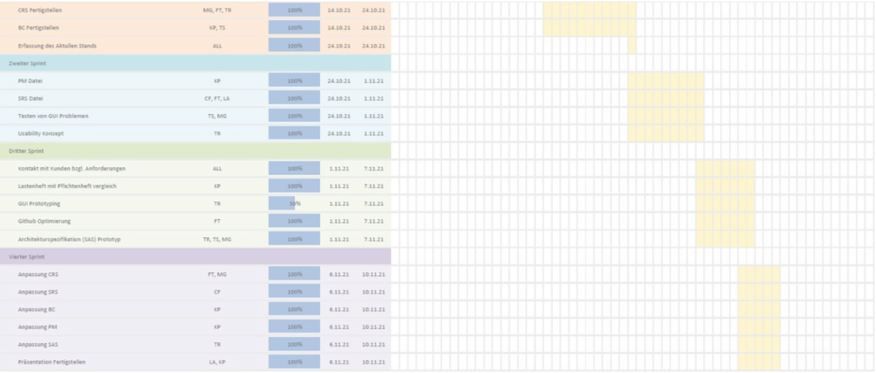
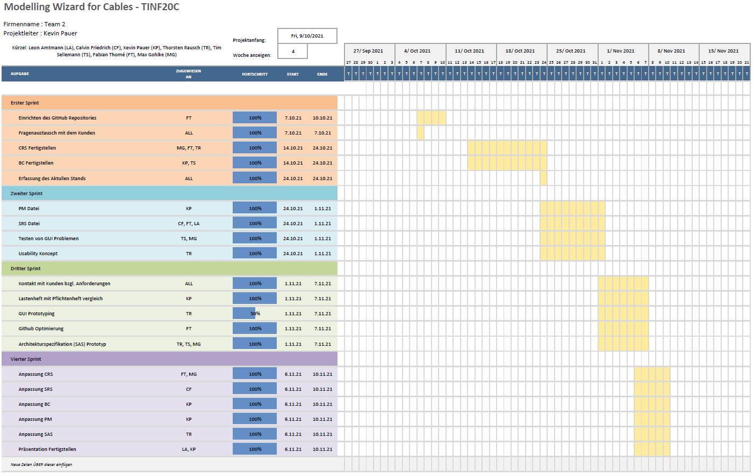
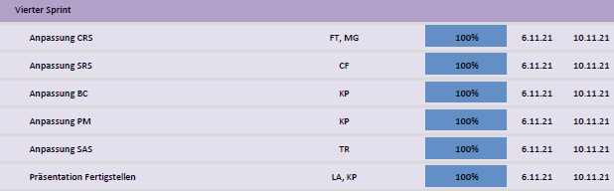
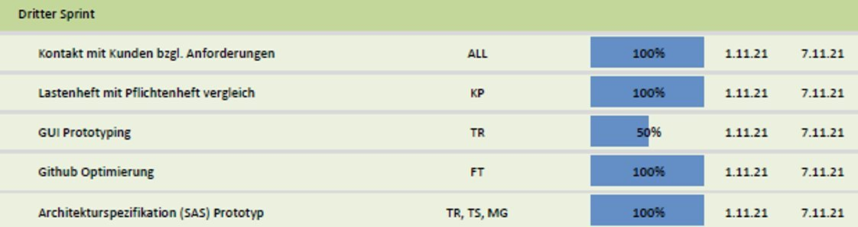
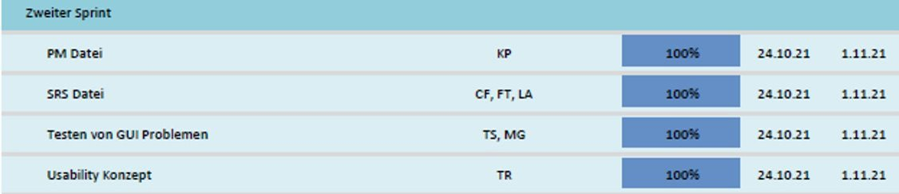
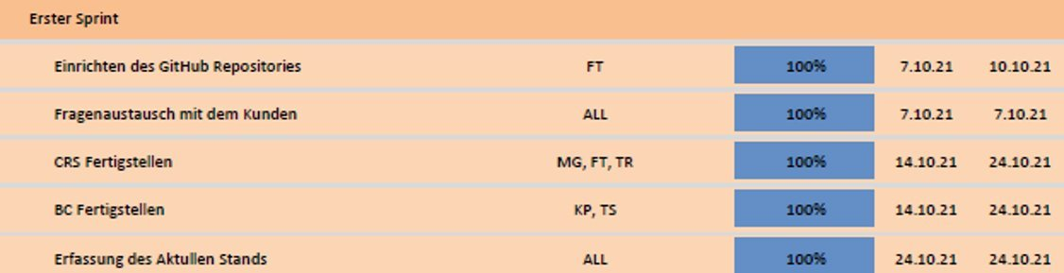
Gantt

Slide 9

SRS
So when you're near me, darling can't you hear me S. R. S. The love you gave me, nothing else can save me S. R. S. When you're gone How can I even try to go on? When you're gone Though I try how can I carry on?

Slide 10
SRS
Purpose
Usecases
Non-functional
Requirements
Product Environment

Slide 11
SRS
Usecases
delete
Purpose
Manage Cable Model List
reorder
Non-functional
Requirements
Download Cable Models as AML Package
List Cables
Edit Cable Models
Product
Requirements
Product Environment

Slide 12
SRS
Purpose
Non-functional
Requirements
Usecases
Lookup of Cable Information
Show Cable Details
Edit Existing Cable
New Cable Registration
Cable Deletion
Product Environment
Product
Requirements

Slide 13
SRS
Usecases
Purpose
As additive for Inventory Management System
Non-functional
Requirements
Docker
Container
Product Environment
Product
Requirements

Slide 14
SRS
Usecases
Reliability
Purpose
Security
Non-functional
Requirements
Future-Proofing
Performance
Scalability
Product Environment
Product
Requirements

Slide 15
SRS
Purpose
Usecases
Non-functional
Requirements
Product Environment

Slide 16

SAS
Usability Concept
Intuitiveness
Reliability
Efficiency
Satisfaction

Slide 17
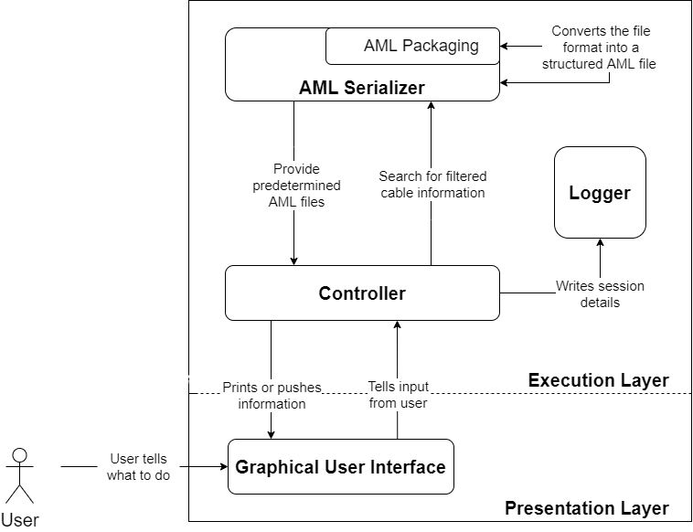
SAS

Slide 18
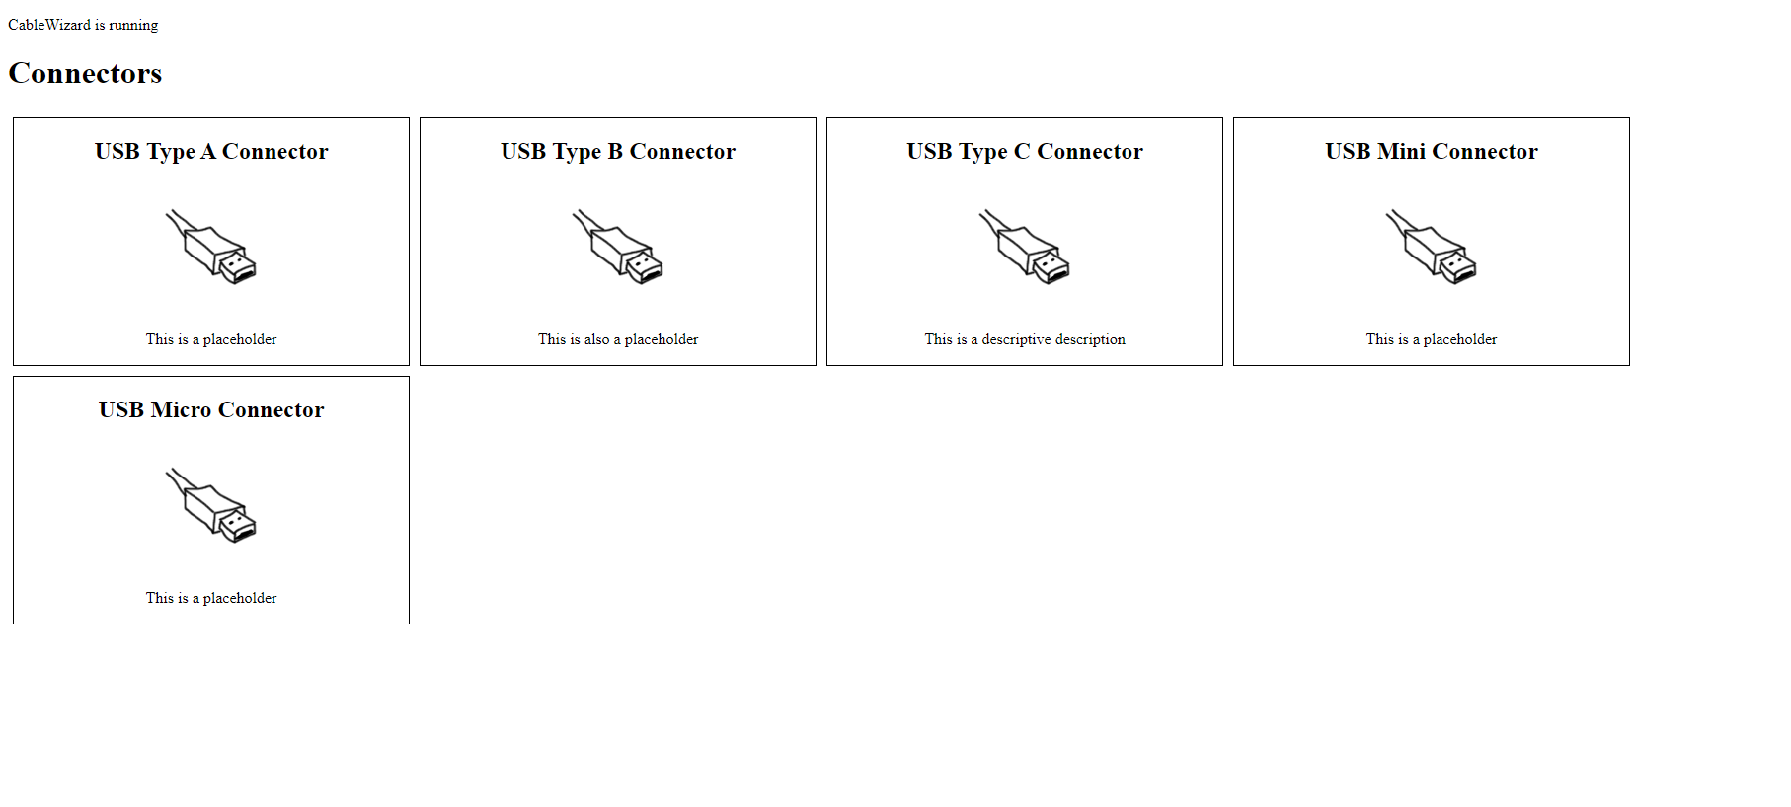
GUI Prototype

Slide 19






